Slide 1
Machine Learning for CS Education:
Predicting Student Grades
from Early Performance
Jacques Sarraffe, Evan Hatton, Erika Mendoza
Faculty advisor: Dr. Suzanne Rivoire

Slide 2

Motivation
Predictive Student Models:
Identify and help struggling students
Enables a mastery learning environment
Enables open learner model

Slide 3
CSEDM Data Challenge
Publicly available dataset (pre-anonymized)
Student ID, problem ID, submission ID, code submission, compiler message
Results from previous phases
Starter code in Python
Track 1: Predicting problem-specific success rates from first 30 problems
Track 2: Predicting final grades from performance during the first half of the semester

Slide 4
Dataset - continued
Training Data Sources: Same Across Both Tracks
First 30 Problems of the Semester
This data includes all problem attempts during that time period
Labels
binary labels - 1 or 0 - indicating if a student struggled on a problem (track 1)
Final grade of students in the training set (track 2)

Slide 5
Track 1
Leaderboard
What we did
How we compared
Struggles/challenges
New learning

Slide 6
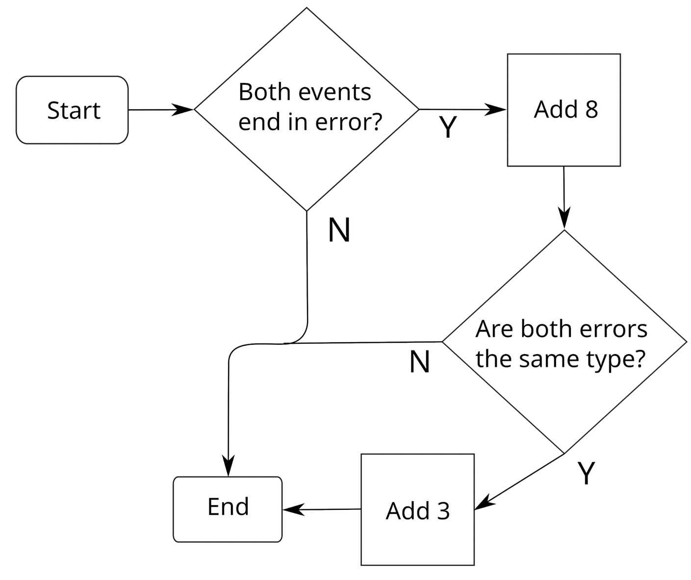
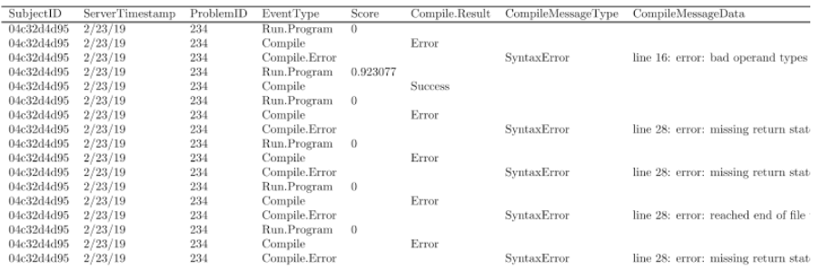
Error Processing
The Error Quotient characterizes how much or how little a student struggled with syntax errors while programming. A perfect EQ for a given session is 0.0. –see diagram, right.

Slide 7
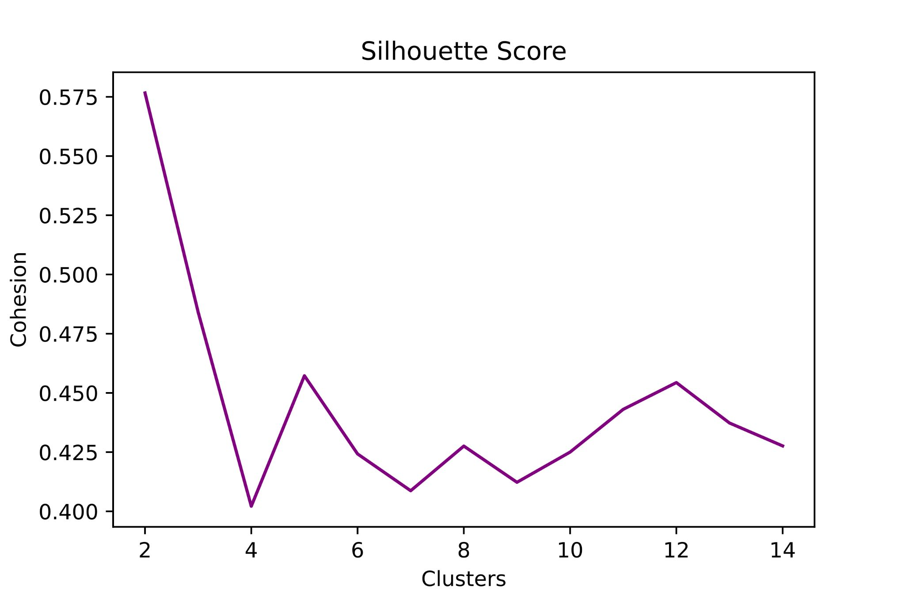
Feature Engineering
Corrected sample code – it didn’t account for student’s unattempted problems
Time Between Events – Two features that counted repeat compilation: ones that occurred within 20 seconds or ones that were over 2 minutes.
Clustering – grouping similarly placed data. Used the KMeans strategy for that
Checked optimal cluster count

Slide 8
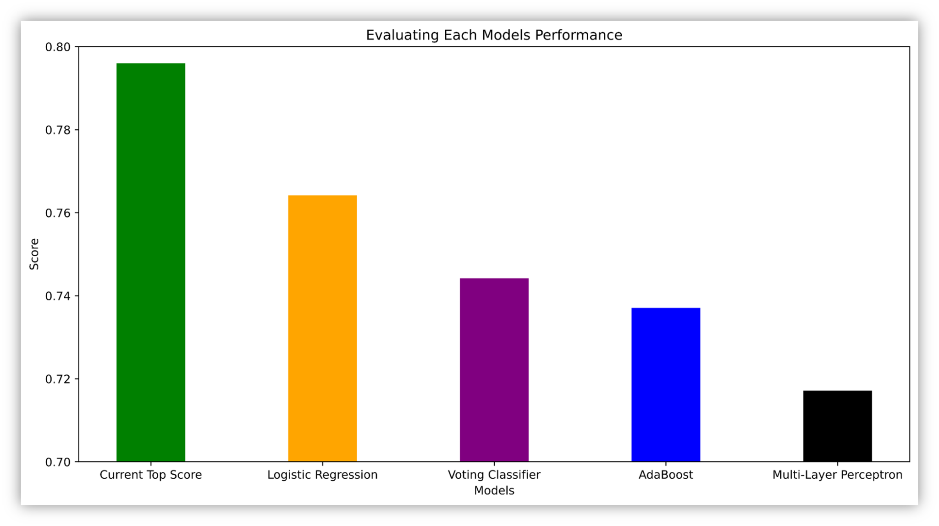
Model Performances
Current Top Score: the highest scoring submission as of 4/23/22 (a PhD student)
Logistic Regression:
similar to linear regression but predicts probabilities of a binary choice
Voting Classifier:
combined AdaBoost, MLP, and Logistic Regression in one model
AdaBoost:
Decision Tree that uses more decision trees on edge cases
MLP:
a neural network with backpropagation

